Slide 1

GYM MANAGEMENT SYSTEM
Project Presentation
Senuth Wickramasinghe, Yogesh Gurung, Ayush Subedi

Slide 2
Executive Summary
The Gym Management System (GMS) automates and streamlines gym operations.
Key Benefits
Core Features
Reduces manual workload
Member registration
Prevents errors
Subscription management
Enhances communication
Service add-ons
Improves customer experience
Payment processing
Automated reporting

Slide 3
Design Analysis Process
Stakeholders & Needs
User Stories: Key Goals
Members
Gym Members
Subscribe to plans, add services, view history, book/cancel classes.
Personal details storage
Membership & service subscriptions
Payment history tracking
Staff
Manage accounts, configure plans, generate reports, track payments.
Staff (Admins & Trainers)
User account management
Plan & service configuration
Subscription & financial tracking

Slide 4
Use Cases Overview
Staff Actions
01
Manage Services & Classes
02
Manage Trainer Schedules
Member Actions
01
03
Register Account
Process Payments
02
04
Subscribe to Plan
Generate Reports
03
05
Manage Services
View Facility Schedule
04
Track Progress
05
Make Payments
06
View Schedule

Slide 5










SDLC Approach: Iterative Model
We adopted the Iterative Model for the GMS development, building and improving the system in cycles. Each cycle included planning, design, development, testing, and evaluation.
Designing
Planning
Developing
Evaluating
Testing

Slide 6




Why Iterative? Key Advantages
Flexibility in Requirements
Gradually refined features as the project evolved.
Early Prototyping
Visualized functionality early, validated approach.
Risk Management
Detected and fixed errors in early stages.
Stakeholder Feedback
Adjusted features to meet practical needs after each cycle.

Slide 7
System Requirements
Functional Requirements
Non-Functional Requirements
What the system does.
How the system performs.
User Registration & Login
Performance (500+ current users)
Membership Management (subscribe, cancel)
Security (encrypted passwords)
Service Management (add, remove, book classes)
Availability & Reliability (daily backup)
Payment & Billing (process, receipts, history)
Usability (desktop/mobile access)
Class & Schedule Management
Scalability (future multi-gym support)

Slide 8
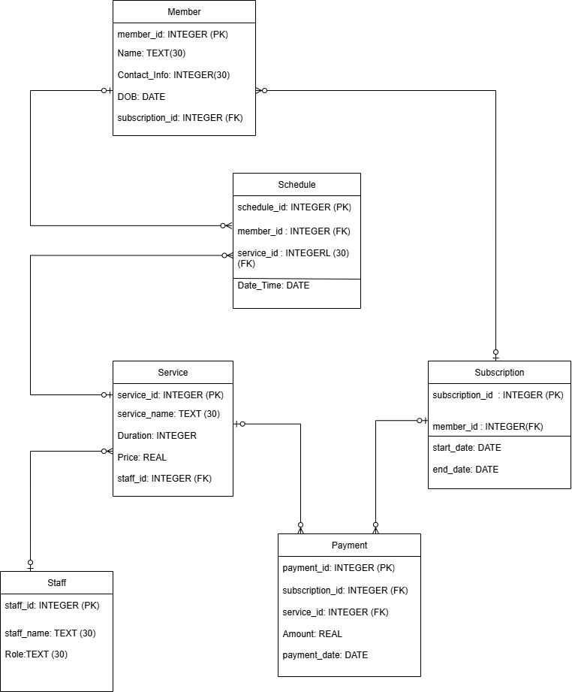
Entity Relationship Diagram
The ERD visually represents the relationships between different entities in our Gym Management System database.
This diagram was a result of detailed brainstorming and iterative refinement to ensure a robust and scalable database structure.

Slide 9






Data Dictionary: Key Tables
Detailed schema for critical database tables, outlining field names, data types, and constraints.
Member
Unique user IDs, names, contact info, DOB, subscription link.
Schedule
Service scheduling details, linked to members and services.
Subscription
Membership details: ID, member, start/end dates.
Service
Optional services: name, duration, price, assigned staff.
Payment
Transaction records: amount, date, linked to subscriptions/services.
Staff
Staff details: name, role, unique ID.

Slide 10

Thank You!
Questions?
Team Contributions
Ayush Subedi
Senuth Wickramasinghe
Yogesh Gurung
Summary, Use Cases, Member & Schedule Table
ERD, User Stories, Use Case Diagram, Staff & Payment Table
Functional & Non-Functional requirements, Service & Subscription Table

